Slide 1
Group Formation

Slide 2
Group
The people working in a factory form a group because, in the context of their occupation, they interact with one another more than they interact with other people, so far as their occupation goes.
Group is basically a collection of two or more persons. The society or the organizations are themselves huge groups of people.
According to Edgar H.Schien, “a group may be defined as a social phenomenon in which two or more persons decide to interact with one another, share common ideology and perceive themselves as a group.”
A group is defined as two or more individuals who are connected to one another by social relationships.

Slide 3
Features of a Group
Two or more people in social interaction.
Rewards to members.
Stable structure.
Members share common interests or goals.
individuals must perceive themselves as a group

Slide 4
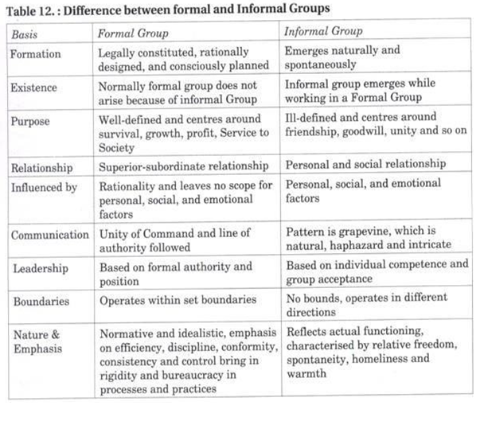

Slide 5
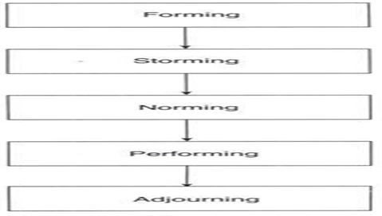
Stages of group development (TEAM PROCESS)
Groups tend to develop in stages. As you work with a support group, or with almost any group people who are working together toward a common cause, you'll be able to see the progression
As a facilitator, knowing what to look for and how to manage the challenges can have a b impact on how your group progresses.

Slide 6
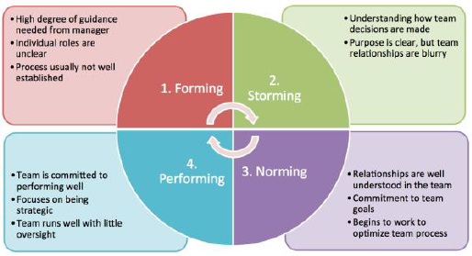

Slide 7
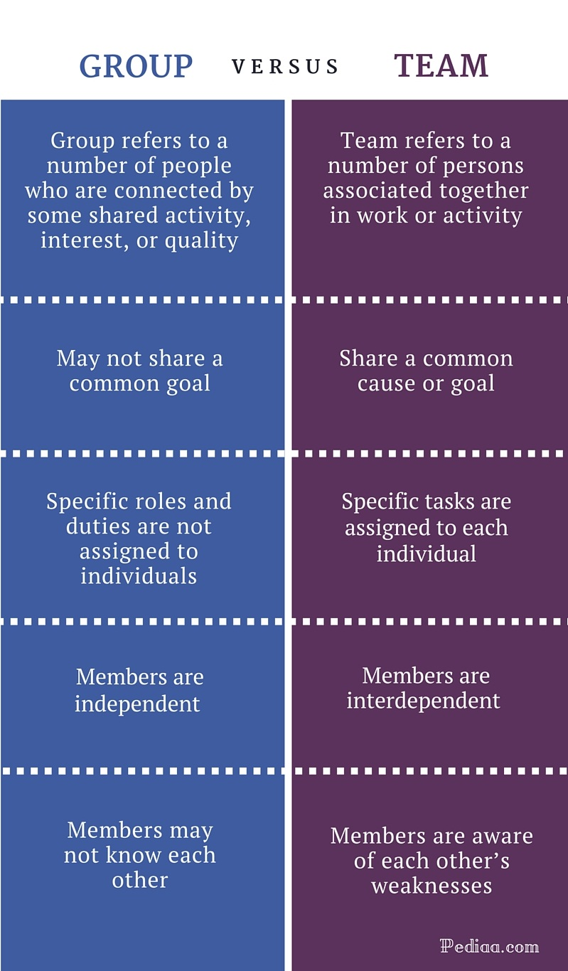
Group vs Teams

Slide 8
Conflict
According to Kae. H. Chung and Loan C. Megginson, “Conflict is the struggle between incompatible or opposing needs, wishes, ideas, interests or people. Conflict arises when individuals, or groups, encounter goals that both parties cannot obtain satisfactorily”
Nature of Conflict
Conflict arises due to persuasion of exclusive goals, values , methods or events by two or more parties mutually. There is a disagreement in two or more aspects of an element like goal, method, interest or process.
Conflict arises die to deliberate interference of one party in an occasion
Conflict occurs when an individual has no alternatives to select from available course of action
Conflict is a dynamic process. It indicates a series of events
It arises out of two perceptions
It is different from competition. In conflict one person interferes in other person’s opportunity to acquire resources or opportunities. In competition both parties try to win without interfering each others.

Slide 9
Types or Levels of Conflicts
Individual level conflict
Inter-group conflict
Inter-organisational conflict
Intra-organisational conflict

Slide 10
CONFLICT MANAGEMENT (Process of Managing Organizational Conflict)
Forcing (Competing)
Win-Win (Collaborating)
Compromising
Withdrawing (Avoiding)
Smoothing (Accomodating)

Slide 11
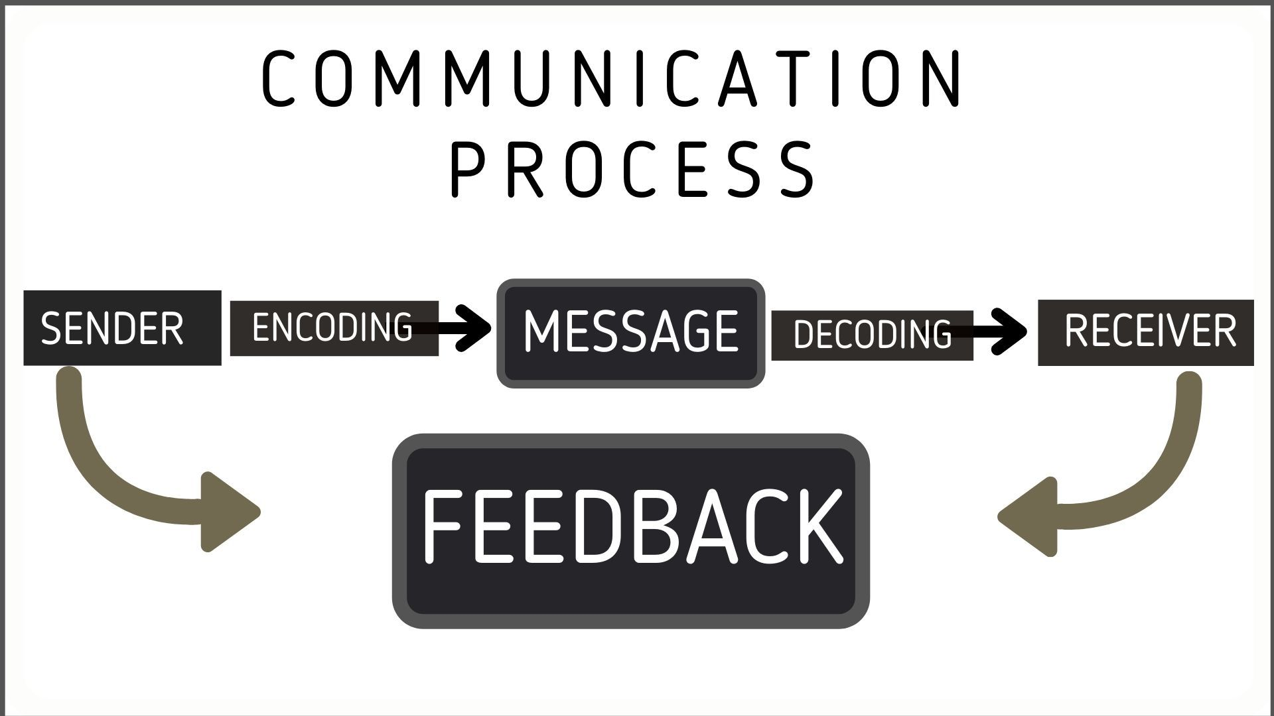
Interpersonal Communication
Communication is simply the act of transferring information from one place to another. Communication process can be defined as the sending and receiving of information between two people.

